Slide 1



HEALTHCARE INSURANCE COST ANALYSIS USING EDA

Slide 2

Project Overview
This project analyzes healthcare insurance data using Exploratory Data Analysis (EDA).
The objective is to understand how factors like age, BMI, smoking habits, and region affect medical insurance charges.

Slide 3


Problem Statement
Healthcare costs vary significantly among individuals.
This project aims to identify the key factors that influence insurance charges and understand their relationship with medical expenses.

Slide 4
Dataset Information
Feature
age : Age of individual
sex : Gender
bmi : Body Mass Index
children : Number of children
smoker :Smoking status
region : Residential region
charges : Medical insurance cost
Total Records: 1338
Total Features: 7
________________________________________

Slide 5

Data
Cleaning
Checked missing values
Checked duplicate records
Verified data types
Dataset was clean and ready for analysis

Slide 6
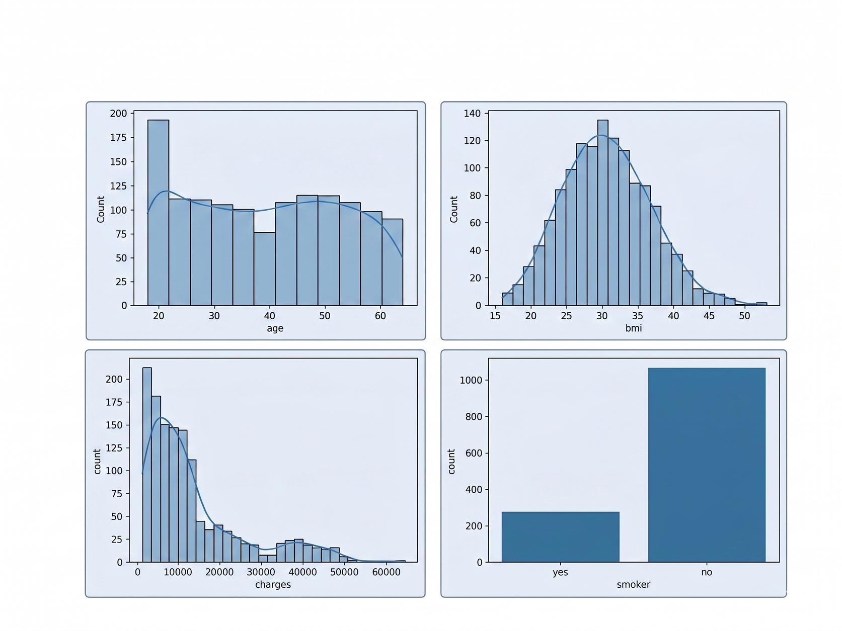
Univariate Analysis
Overall, the dataset shows a mix of balanced and skewed distributions.¶
Numerical features like age and BMI are fairly well spread, while charges show a strong right skew with few high-cost cases.
Categorical features such as sex and region are balanced, but smoker status is highly imbalanced, which is likely to be a key factor influencing insurance cost.

Slide 7
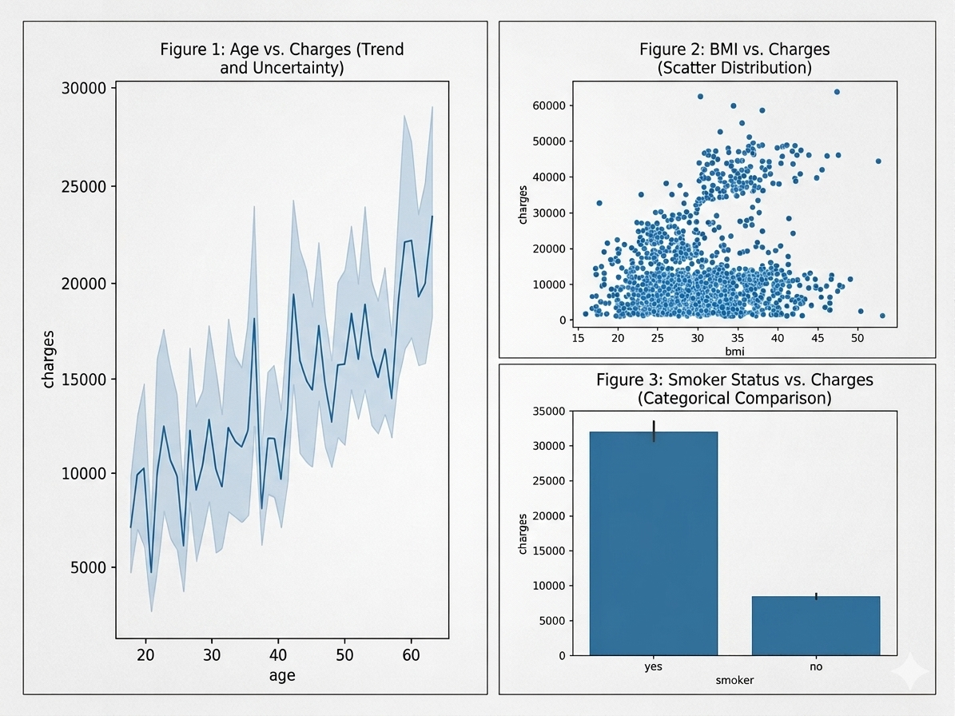
Bivariate Analysis
From the bivariate analysis, it is clear that insurance charges are not influenced equally by all features. The most important factor is smoking status, which shows a very strong impact—smokers have significantly higher charges compared to non-smokers.
Other variables like age and BMI show a weak positive relationship with charges, indicating that costs increase slightly with higher age and body mass index, but the effect is not strong on its own.
Overall, the analysis suggests that lifestyle-related factors (especially smoking) are the key drivers of medical insurance cost, while demographic factors play a secondary or minimal role.

Slide 8
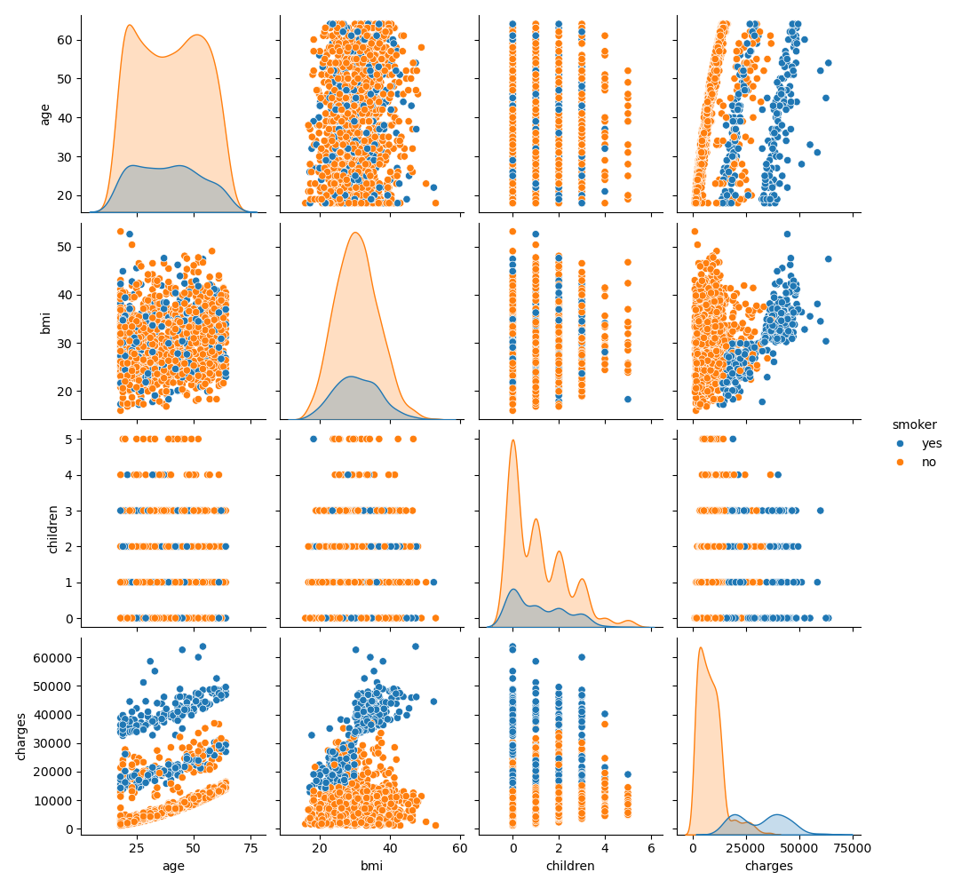
Multivariate Analysis
The multivariate analysis reveals that insurance charges are influenced by the combined effect of multiple factors such as age, BMI, and smoking status. Among all variables, smoking emerged as the most significant factor associated with higher medical expenses.

Slide 9


Key Findings
Smoking is the most influential factor
BMI and age strongly affect charges
Non-smokers generally have lower expenses
Region has relatively smaller impact

Slide 10

Conclusion
EDA revealed that smoking, BMI, and age are the major factors affecting healthcare insurance costs.
Smokers showed significantly higher medicalexpenses compared to non-smokers.

